Slide 1
2016 Profiles of Student Life:
Attitudes & Behaviors Study
Midland Kids First
April 13, 2016
© The Legacy Center for Community Success

Slide 2
Thank You!
to The Herbert H. and Grace A. Dow Foundation and Mid State Health Network for financial support.
to the superintendents who pledged their support for the survey.
to the school administrators and technical support staff at the 11 schools who assisted us with the implementation.

Slide 3
Attitudes & Behaviors Survey
Developed by the Search Institute, Minneapolis, Minn.
Based on 40 Positive Character Traits (also known as Assets) that all teens should possess
Assesses 24 Risk-Taking Behaviors
The Legacy Center has conducted the study three times in Midland County (2006/2011/2016)

Slide 4
Why repeat the survey?
Because our kids change and so do the challenges they face. For example:
  Explosion of social media and online entertainment
  Increase in e-Cigarette use among youth
  Concerns about student safety and school security
  Surge in anxiety and depression levels
  Rise in academic expectations
  Growth in opiate use among our young adult population (24-35 years)
  Normalization of marijuana = Perception of Risk

Slide 5
Demographics
All Midland County public schools participated, except Midland Academy.
87.6% participation rate vs. 86% and 81% in 2011 and 2006, respectively
Participants (Public School 6th-12th graders)
  5698 total sample size
    2782 female
    2876 male
* Note: Male/Female numbers do not add up to “Total Sample” figure due to missing information on individual surveys. In addition, the total sample size does not equal countywide enrollment figures due to the disqualification of surveys for missing data (>40 questions), pattern filling and other reasons.

Slide 6
Developmental Assets
20 External Assets
(Relations with others)
20 Internal Assets
(Intrinsic Traits)
Support
Empowerment
Boundaries & Expectations
Constructive Use of Time
Commitment to Learning
Positive Values
Social Competencies
Positive Identity
Notes:
External Assets are the positive developmental experiences that families, schools, neighborhoods, community groups and other youth and family-serving organizations provide young people.
Internal Assets are the positive commitments, skills and values that form a young person’s inner guidance system.

Slide 7
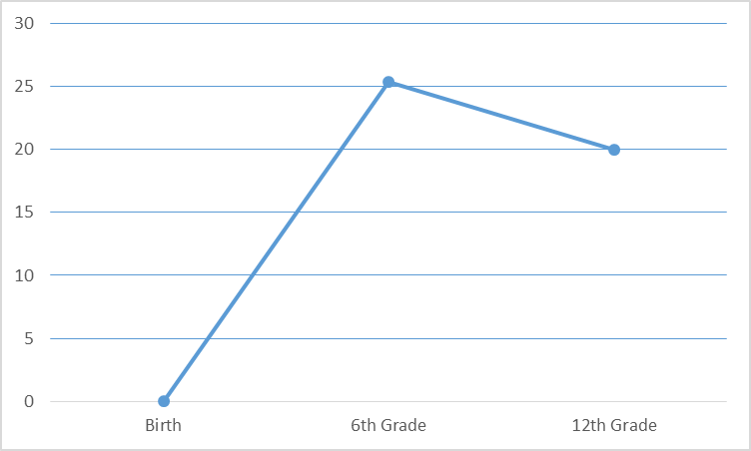
Assets Over Time
25.4
“Institutions”
Family
School
Faith-Based Orgs
Community
“Peers”
20
“Tipping Point” occurs at onset of adolescence; “Peers” supersede “Institutions”
0
Notes:
Sixth grade is the tipping point for many kids – it’s when they start to assert their independence and move away from institutions like family, school and church and more toward their peers.

Slide 8
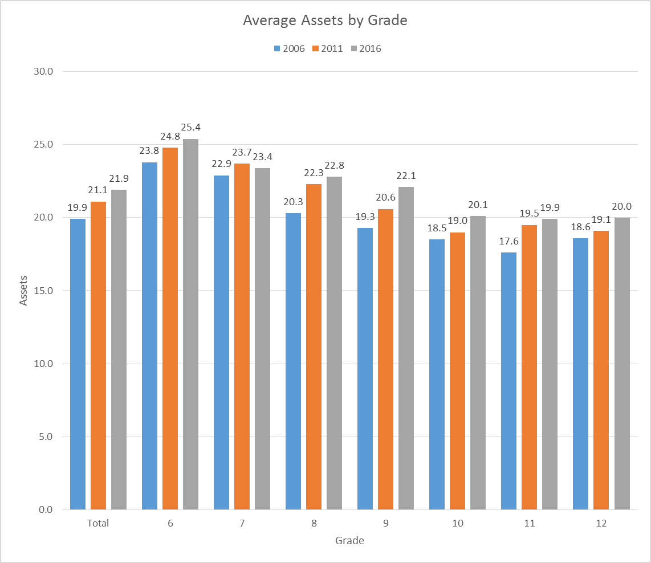
Average Assets by Grade
Notes:
As you can see, the average number of Assets in our youth population continues to increase, with the exception of 7th grade which dipped slightly.
I am pleased to report, that today’s 6th graders have an average of 25.4 Assets compared to 23.8 in 2006 and 12th graders have an average of 20 Assets, compared to 18.6 in 2006.
So our youth are entering adolescence with a higher # of Assets, and they are leaving high school with a higher level.

Slide 9
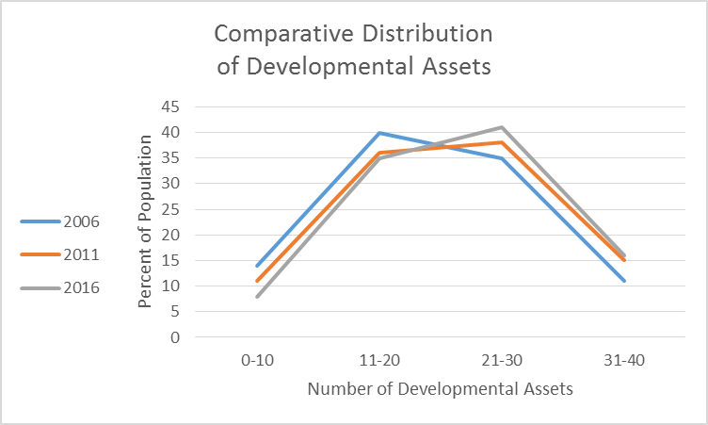
Comparative Distribution
Notes:
The important thing to note from this slide is that a larger percentage of the population has 21 or more Assets and a smaller percentage has less than 20.

Slide 10
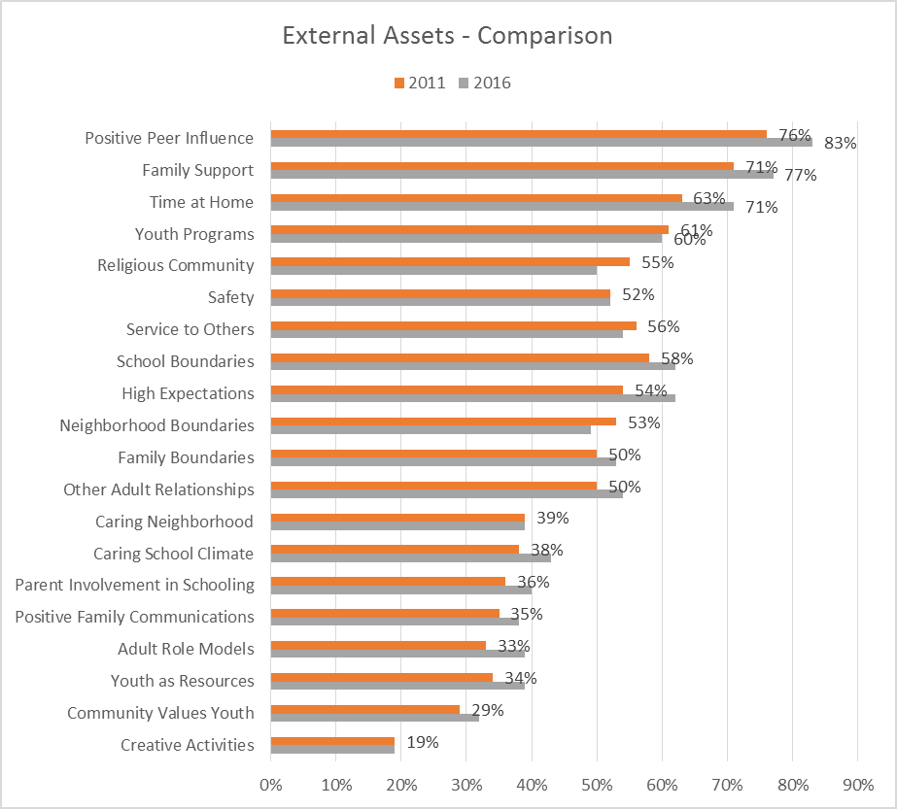
External Comparison
2011/2016
Notes:
This is a list of the External Assets – those that have to do with relationships with other people.
I’m not expecting you to see the details of this chart, but I do want you to notice how, in most cases, the 2016 results far outpace 2011.

Slide 11
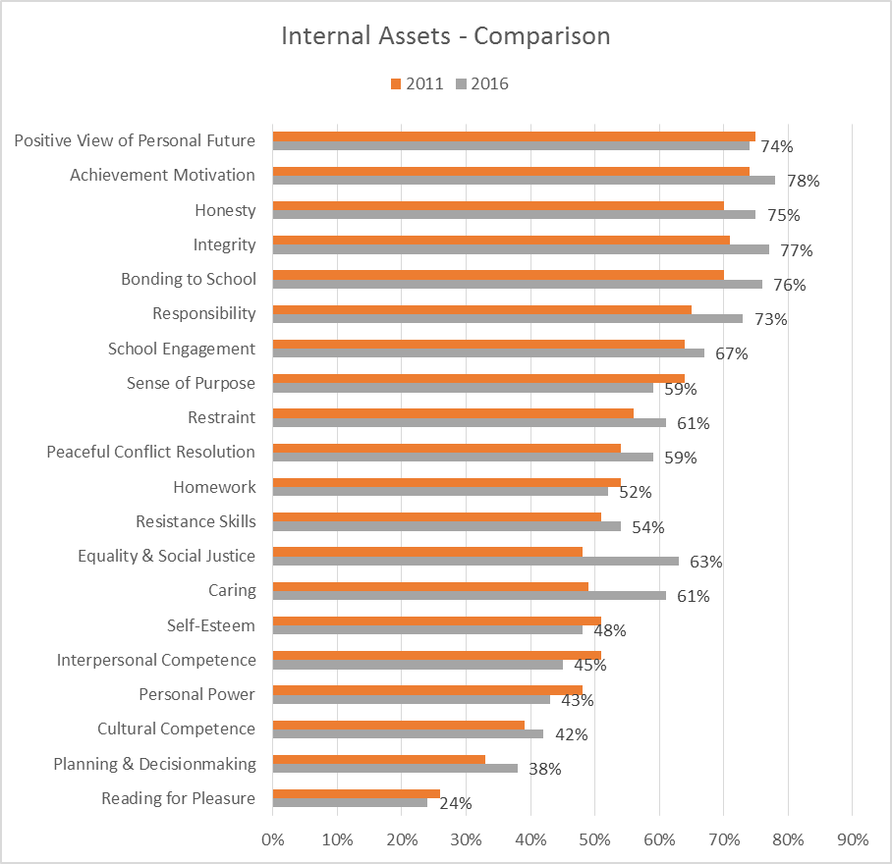
Internal Comparison
2011/2016
Notes:
These are the Internal Assets – those that have to do with who you are as a person – ethics, values, identity, etc. Again, in most cases, 2016 outpaces 2011.

Slide 12
2011 Regression Analysis
In 2011, we conducted a regression analysis on the survey results.
This analysis produced a list of “Priority” Assets that positively impact the risk-taking behaviors exhibited by our youth.
Those Priority Assets include
  Positive Peer Influence – Young person’s best friends model responsible behavior
  Restraint – Young person believes it is important not to be sexually active or to use alcohol or other drugs
  Resistance Skills – Young person can resist negative peer pressure and dangerous situations
  Adult Role Models – Parent(s) and other adults model positive, responsible behavior
These are the Assets our community has been trying to instill in our youth over the past five years.

Slide 13
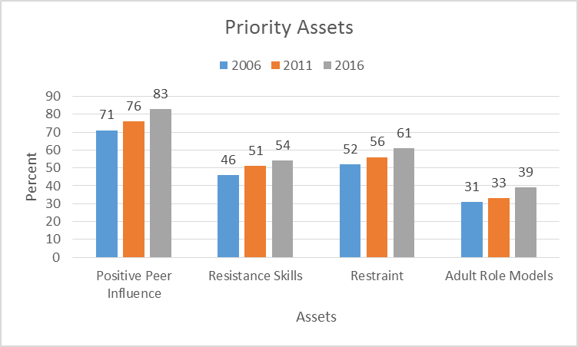
2011 Priority Assets
Notes:
As you can see, the percentage of youth in our community who have these Priority Assets continues to grow.

Slide 14
2016 Regression Analysis
We conducted a regression analysis on the recent survey results
The regression resulted in a slightly modified list of “Priority” Assets
  Positive Peer Influence
  Restraint
  Resistance Skills
  Achievement Motivation: Young person is motivated to do well in school.
  Adult Role Models
Notes:
The Asset entitled Achievement Motivation, which is defined as a young person is motivated to do well in school, impacts nearly every risk-taking behavior exhibited by our youth population. As a result, we have added this Asset to our priority list.

Slide 15
“Significant” Improvement
External assets with an increase of 5 percentage points or more vs 2011
  Family Support [71% → 77%]
  Caring School Climate 38% → 43%]
  Youth as Resources [34% → 39%]
  School Boundaries [58% → 62%]
  Adult Role Models [33% → 39%]
  Positive Peer Influence [76% → 83%]
  High Expectations [54% → 62%]
  Time at Home [63% → 71%]
Notes:
Since 2011, we have seen significant improvement in these External Assets – at least 5 percentage points.

Slide 16
“Significant” Improvement
Internal Assets with an increase of 5 percentage points or more vs 2011
  Bonding to School [70% → 76%]
  Caring [49 → 61%]
  Equality & Social Justice [48% → 63%]
  Integrity [71% → 77%]
  Honesty [70% → 75%]
  Responsibility [65% → 73]
  Restraint [56% → 61%]
  Planning & Decision-Making [33% → 38%]
  Peaceful Conflict Resolution [54% → 59%]
Asset Category:
Positive Values
Notes:
We have seen significant improvement in these Internal Assets over the same period of time. Interestingly, the entire category of Positive Values improved significantly.

Slide 17
“Significant” Decreases
3 Assets have decreased by 5 percentage points or more vs 2011
  Religious Community [55% → 50%]
  Sense of Purpose [64% → 59%]
  Interpersonal Competence [51% → 45%]
Notes:
Of the 11 Assets that decreased, only 3 decreased significantly.

Slide 18
Risk-Taking Behaviors
Developmental Assets have the power to protect our youth from engaging in the following 24 risk-taking behaviors:
Alcohol Use
Binge Drinking
Marijuana Use
Smokeless Tobacco Use
Illegal Drug Use
Driving While Drinking
Early Sexual Intercourse
Vandalism
Inhalant Use
Smoking
Shoplifting
Using a Weapon
Eating Disorders
Skipping School
Gambling
Depression
Getting into Trouble
Hitting Another Person
Hurting Another Person
Fighting in Groups
Carrying a Weapon for Protection
Threatening to Cause Physical Harm
Attempting Suicide
Riding with an Impaired Driver
Notes:
So we’ve talked a lot about how the survey measured the level of Developmental Assets in our youth population.
However, it also measured the level of Risk-Taking Behaviors. This is a list of the 24 Risk-Taking Behaviors included in the survey.
The nine that are bold represent Substance Abusive behaviors. We’ll talk about those in a few minutes.

Slide 19
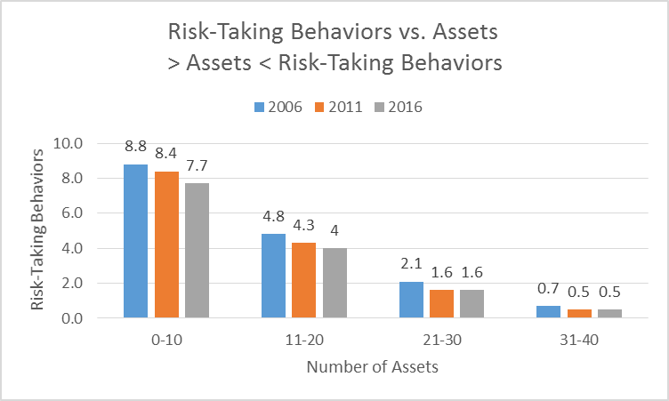
Risk-Taking vs. Assets
Notes:
Research shows the more Assets youth have, the less likely they are to engage in risky behavior.
Our results support that assertion.
The level of risk-taking behavior among those with 21 or more assets remains very low.
If you recall a few slides back, I pointed out that a larger percentage of our youth have more than 21 assets!
You will also notice that risk-taking behavior among youth with les than 21 Assets is declining, as well.

Slide 20
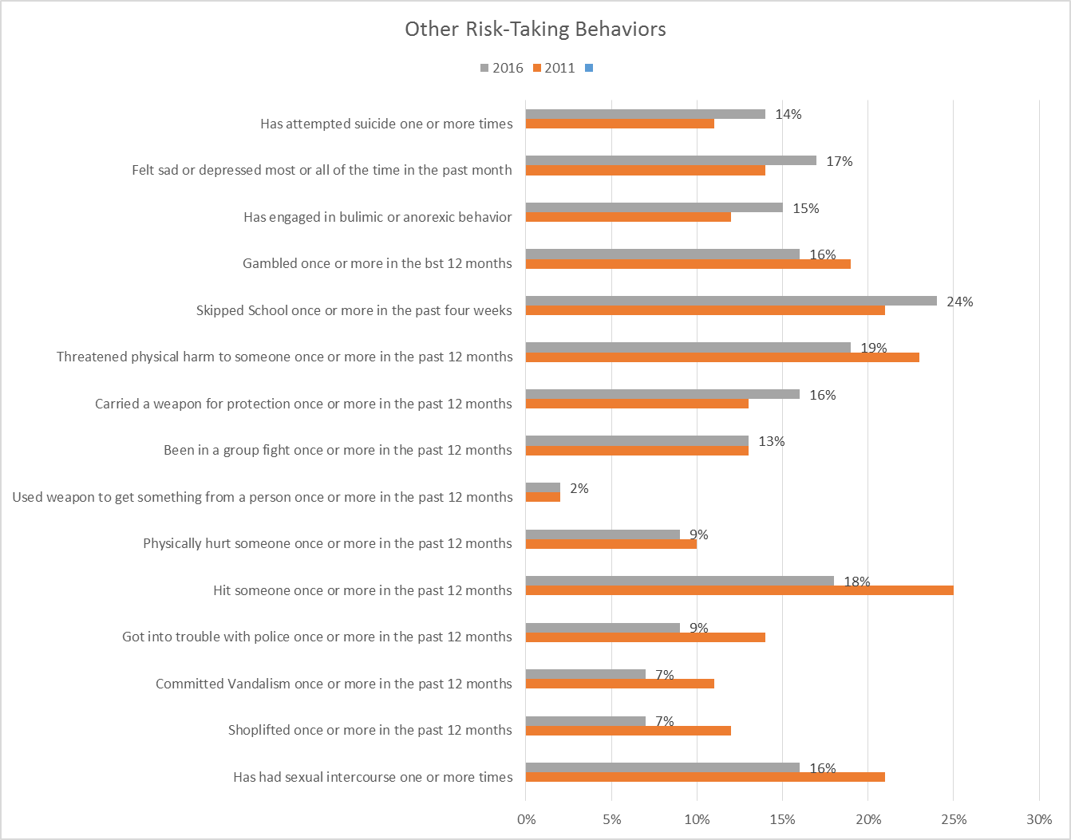
Risk-Taking Behaviors
Notes:
These are Risk-Taking Behaviors - not related to substance use. I’d like to call your attention to the gray bar, which represents 2016. I’m pleased to report that Risk-Taking Behavior has decreased in all but five categories:
Attempted Suicide
Depression
Eating Disorders
Truancy
Carried a Weapon for Protection

Slide 21
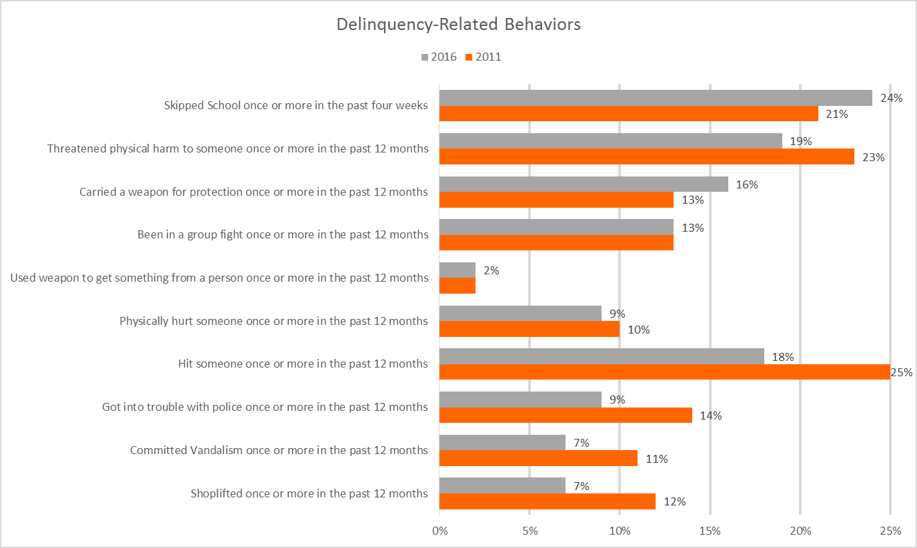
Delinquency-Related Behaviors
Notes:
Let’s take a closer look at delinquency-related behaviors.
As a county, we’ve made great progress in reducing these behaviors.
Unfortunately, we’re slipping in a few key areas.
The following slides indicate which assets directly impact school truancy, antisocial behavior and violence.
There are common themes.

Slide 22
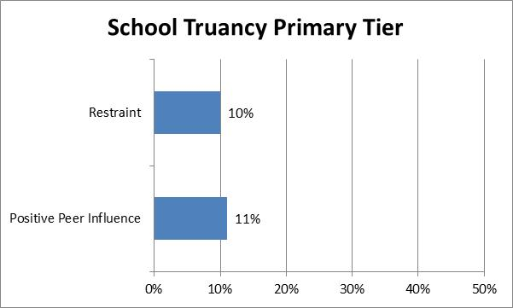
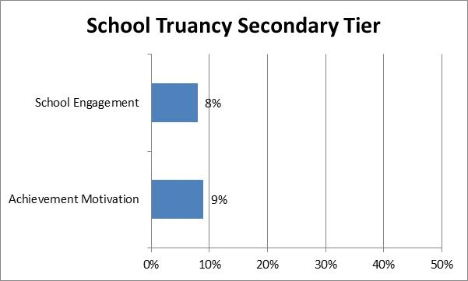
School Truancy

Slide 23
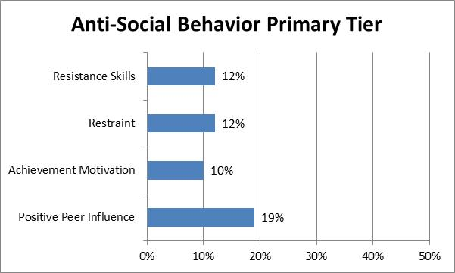
Anti-Social Behavior

Slide 24
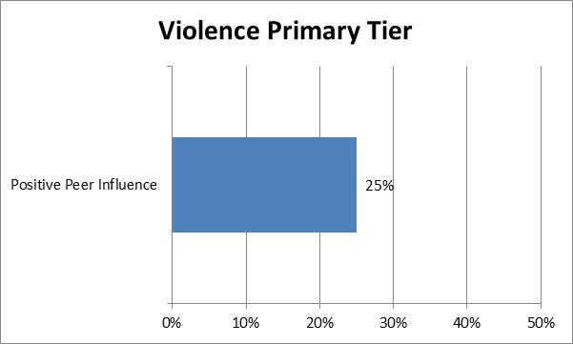
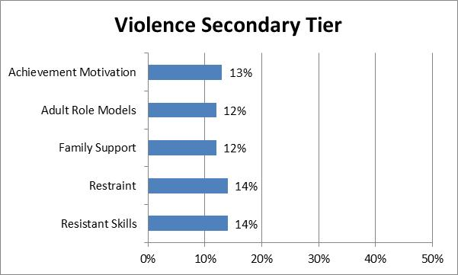
Violence

Slide 25
Areas of Concern
The following Risk-Taking Behaviors have increased
  Eating Disorders [12% → 15%]
  Depression [14% → 17%]
  Suicide Attempts [11% → 14%]
Assets related to Positive Identity decreased
  Personal Power [48% → 43%]
  Self-Esteem [52% → 48%]
  Sense of Purpose [64% → 59%]
  Positive View of Personal Future [75% → 74%]
Notes:
As mentioned earlier, Eating Disorders, Depression and Suicide Attempts all have increased, which is cause for concern.
We’ve lost ground on the Assets related to Positive Identity, and there is a direct correlation between these assets and these risk-taking behaviors.
Let’s take this beyond the percentages…

Slide 26
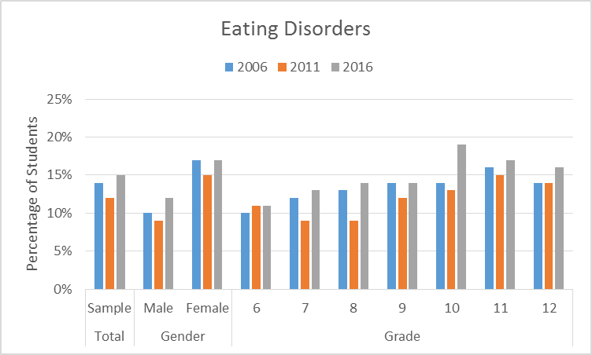
Eating Disorders
855
Students
Notes:
Fifteen percent of our youth population reported that they engaged in bulimic or anorexic behavior. That is 855 students!
The Assets that impact this behavior include: Sense of Purpose, Self-Esteem, Positive Peer Influence and Safety, followed closely by Personal Power, Resistance skills and Achievement Motivation.

Slide 27
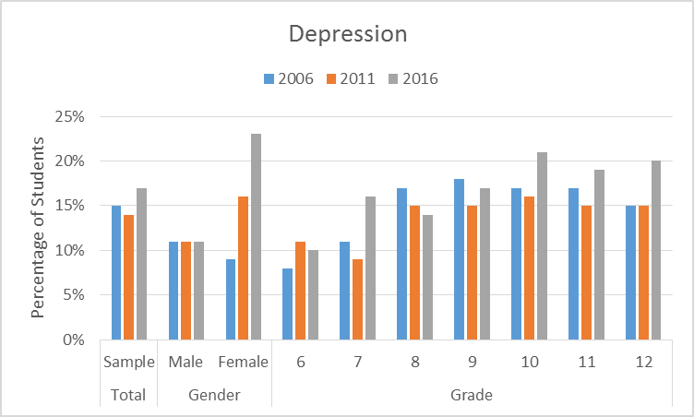
Depression
969
Students
Notes:
Seventeen percent of our youth population reported they were sad or depressed most of the time in the month prior to the survey. That’s 969 students!
Notice the significant increase in this behavior among our female population.
The Assets that impact this behavior include: Sense of Purpose, Self-Esteem, Personal Power and Family Support.

Slide 28
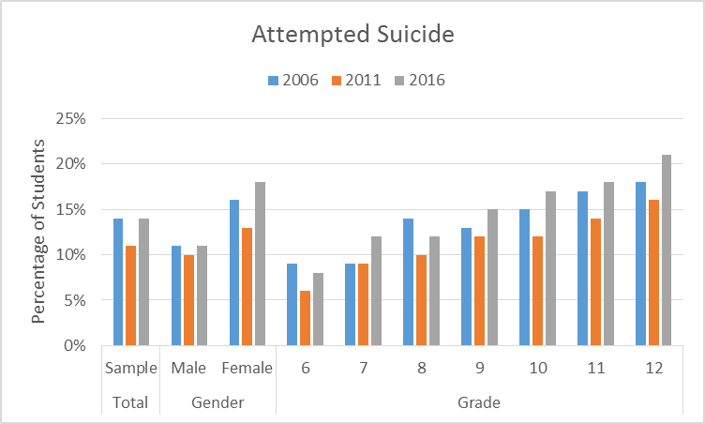
Attempted Suicide
798
Students
Notes:
And lastly, 14% of our youth population reported that they had attempted suicide one or more times. We’re talking about 798 students!
The Assets that impact this behavior include: Sense of Purpose, Self-Esteem, Positive Peer Influence and Family Support.

Slide 29
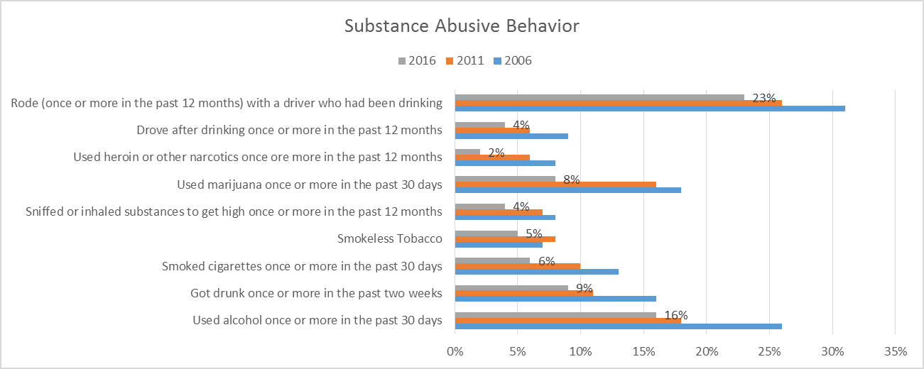
Substance Abusive Behavior
Notes:
Now we’re going to take a look at Risk-Taking Behaviors specifically related to substance use.
I’m pleased to report that substance use trends are going in the right direction.
In our opinion, this can be attributed to the increase in assets among our youth population, as well as the unprecedented level of collaboration taking place in our community at all levels.
Youth Connections magazine, town hall meetings sponsored by the Community Alliance 4 Youth Success, as well as other local activities have highlighted the importance of Assets and provided valuable information to parents about the dangers of substance use by adolescents.

Slide 30
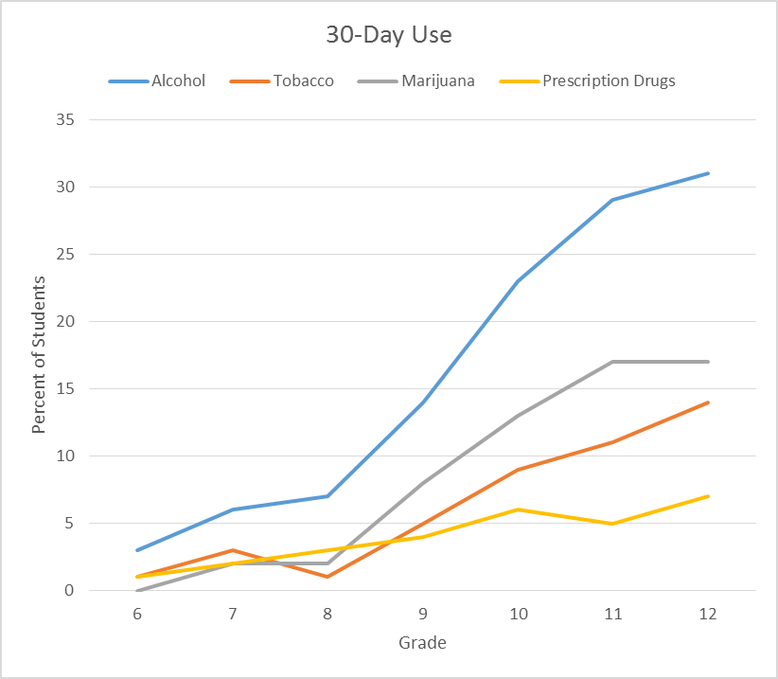
30-Day Use by Grade
Notes:
This graph shows 30-Day Use of each substance, by grade. Alcohol continues to be the most abused substance, far outpacing marijuana, tobacco and prescription drugs. As you would expect, there is a strong correlation between grade and usage.

Slide 31
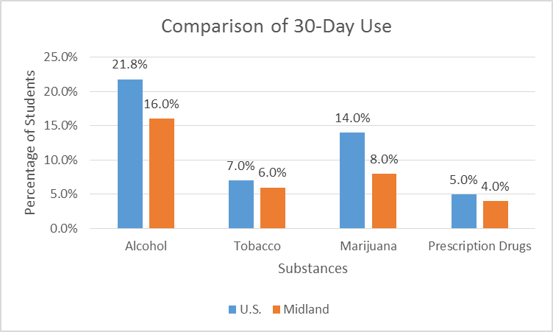
30-Day Use Comparison
Notes:
People often ask us how Midland compares to state or national trends when it comes to substance use. And I’m pleased to report that we are doing better than national trends in all substance use categories. The national data shown here is courtesy of the 2015 Monitoring the Future study conducted annually by University of Michigan.

Slide 32
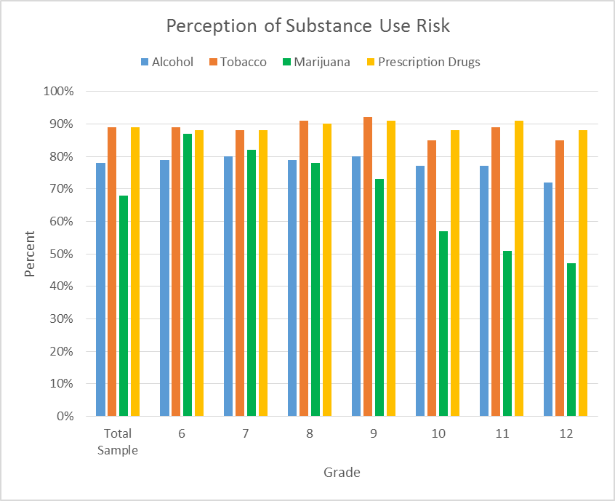
Perception of Risk
Notes:
This chart shows perception of risk, by grade. Our concern here is the low percentage of kids who believe there is moderate or great risk from “regular use of marijuana.” Less than 50 percent of our 12th graders believe there is risk.
A proposal to legalize marijuana for recreational use could be on the ballot in November. Research shows that a reduction in perceived risk typically is a predictor of increased use.
The Community Alliance 4 Youth Success launched a campaign this month, coinciding with the Spring issue of Youth Connections, to bring attention to this issue. The magazine directs people to the coalition’s website – www.drugfreemidland.org – for more information about the impact of legalization on youth. Additional information will be posted in July and October.

Slide 33
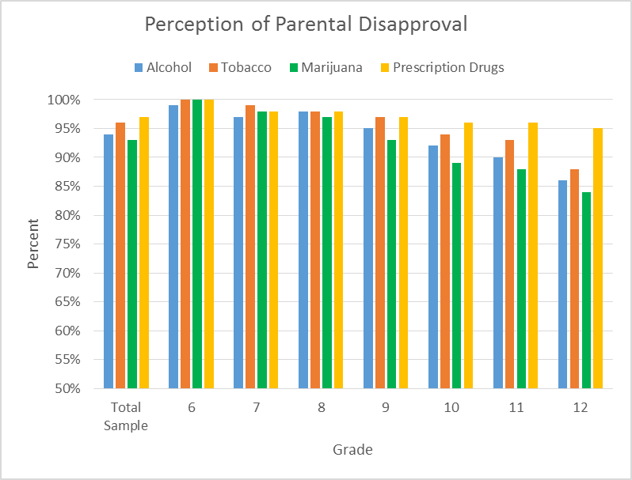
Parental Disapproval

Slide 34
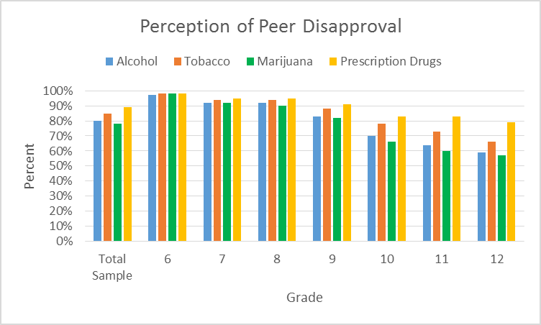
Peer Disapproval

Slide 35
Conclusions
Our efforts are paying off!
  Assets have increased
  Risk-Taking Behaviors have decreased
  The Developmental Assets concept is firmly embedded in our community, and we are continuing to make progress.
Kuddos to the many organizations who have joined us on our Asset journey
But we still have work to do!

Slide 36
Next Steps
Continue analyzing data
Share results with key stakeholders and general public via presentations and media.
Host meeting with YMP Steering Committee to review the study and develop a plan to tackle key issues.
We need to continue working together to instill assets in our youth to enable positive long-term outcomes.

Slide 37
THANK YOU! www.tlc4cs.org/youth-development/

